Slide 1
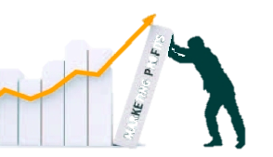
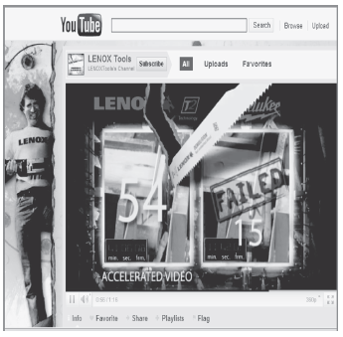
The Customer Experience
and Value Creation
MBM6
Chapter 4
Understanding the Customer Experience
Chapter 4 Objectives
Understanding the customer experience
Measuring customer value in dollar savings.
Measuring perceived customer value.
Identifying value drivers and level of price sensitivity.
This is the first step in value creation.
Copyright Roger J. Best, 2012

Slide 2
The Customer Experience
and Value Creation
MBM6
Chapter 4
Understanding the
Customer Experience
In this section we will look at different ways companies work to understand the customer experience.
Copyright Roger J. Best, 2012
Copyright Roger J. Best, 2011

Slide 3
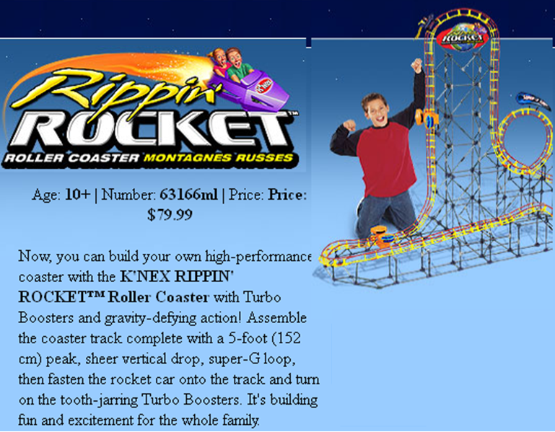
The Customer Experience
MBM6
Chapter 4
K'Nex Rippin' Rocket Roller Coaster
One of the year's hottest toys.
Customer (Parent) Experience:
After 40 minutes of trying, I quit, having completed only a few pages of the 80-page instruction manual.
Design & Usability Testing Center (*)
At the lab, we observe people putting stuff together and then they try to help manufacturers simplify their instructions.
"We're used to being tortured by products," said Bill Gribbons, who runs the lab.
He says companies often design products for their own convenience, rather than consumers.
* Bentley College, Massachusetts
Copyright Roger J. Best, 2012

Slide 4



Empathic Design
MBM6
Chapter 4
Honda uses Empathic Design by video taping women shoppers putting groceries in and taking them out a trunks.
How does this help Honda better understand the customer experience and improve their trunk design?
Copyright Roger J. Best, 2012

Slide 5
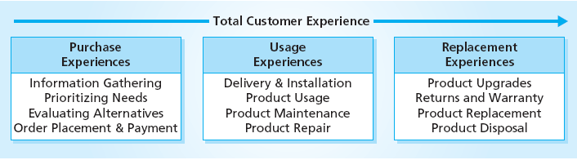


Understanding the Customer Experience
MBM6
Chapter 4
Same product, different experiences. What would you learn from understanding all aspects of each customer’s product experience?
Copyright Roger J. Best, 2012

Slide 6
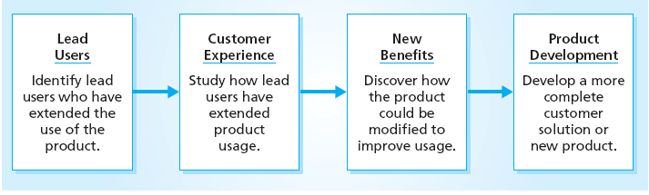
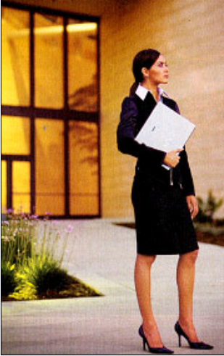
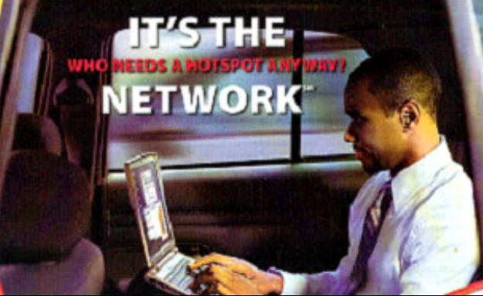
Why Focus on Lead Users?
MBM6
Chapter 4
Copyright Roger J. Best, 2012

Slide 7
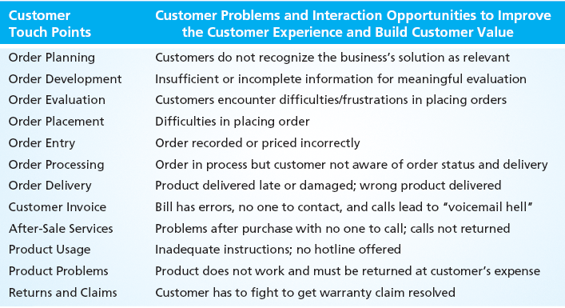
Improving the Customer Experience
MBM6
Chapter 4
How well does Bank of America manage customer touch points?
How does their performance impact their brand image?
Copyright Roger J. Best, 2012

Slide 8
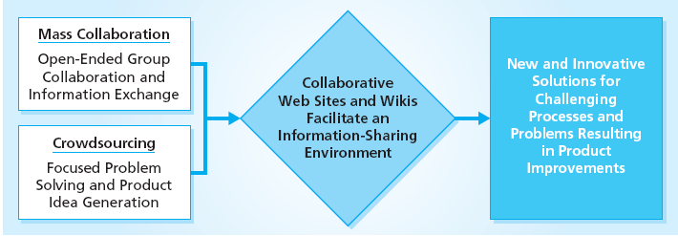
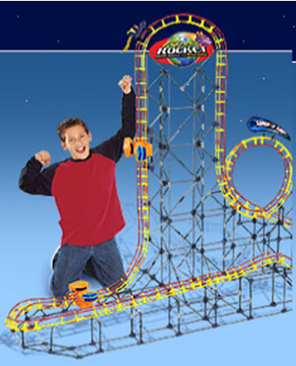
Customer Collaboration & Ideation
MBM6
Chapter 4
How could this toy manufacturer use customer collaboration to solve this toy assembly nightmare?
Copyright Roger J. Best, 2012

Slide 9
The Customer Experience
and Value Creation
MBM6
Chapter 4
Measuring Customer Value in Dollar Savings
In this section we will look at different ways companies can assess the dollar value they create in customer savings relative to competitors.
Copyright Roger J. Best, 2012

Slide 10
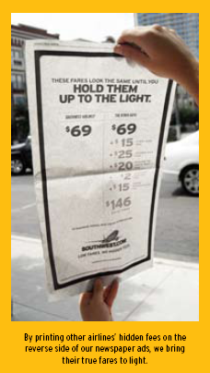
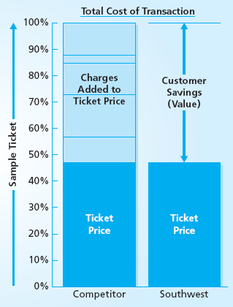
Southwest Airlines
Total Cost of Purchase
MBM6
Chapter 4
Copyright Roger J. Best, 2012

Slide 11
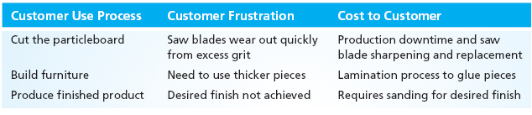
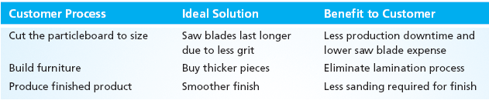
Understanding the Customer Experience
MBM6
Chapter 4
Furniture Manufacturer: Current Customer Experience
Furniture Manufacture: Customer’s Preferred Experience
Furniture manufacturers buy the lowest priced particle board for the interior furniture parts. How would the information above be used to create a higher priced product?
Copyright Roger J. Best, 2012

Slide 12
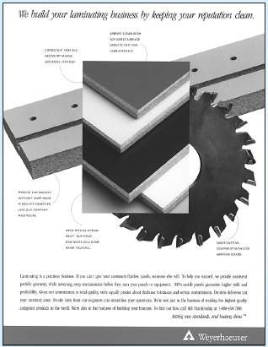
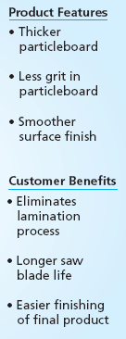
Creating Customer Value
at a Higher Price
MBM6
Chapter 4
Weyerhaeuser saved manufacturer’s millions of dollars with a product that:
Eliminated the lamentation process
Extended the life of saw blades
This enabled the company to charge a premium price and still create considerable customer savings.
Copyright Roger J. Best, 2012

Slide 13
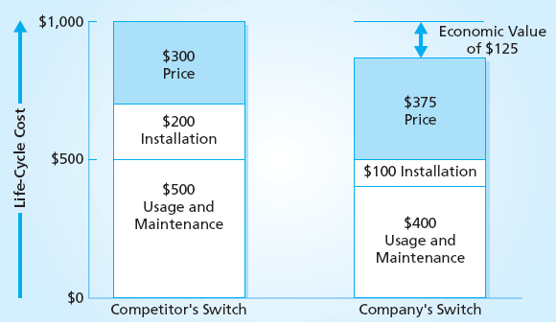
Lifecycle Costs & Customer Value
MBM6
Chapter 4
This company’s telecommunications switch is $75 more expensive that the competitors. Why would a company that buys 10,000 switches per year pay more for the company’s switch (an extra $750,000 per year)?
Copyright Roger J. Best, 2012

Slide 14
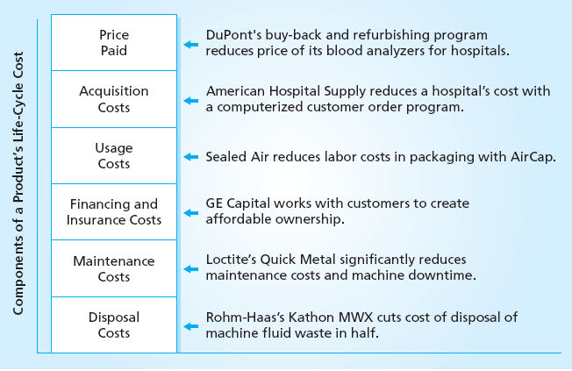
Sources of Value Creation
MBM6
Chapter 4
How could a printer manufacturer lower the life-cycle cost of a printer?
Copyright Roger J. Best, 2012

Slide 15
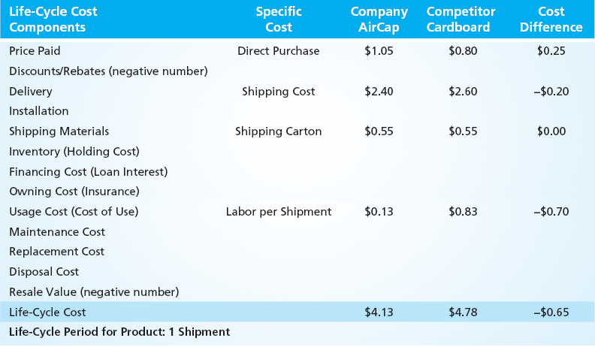
AirCap Total Cost per Shipment
Marketing Performance Tool 4.1
Customer Application: Shipping a $500 electronic instrument
How can AirCap charge $0.25 more for packaging material per shipment than their competitor?
Copyright Roger J. Best, 2012

Slide 16
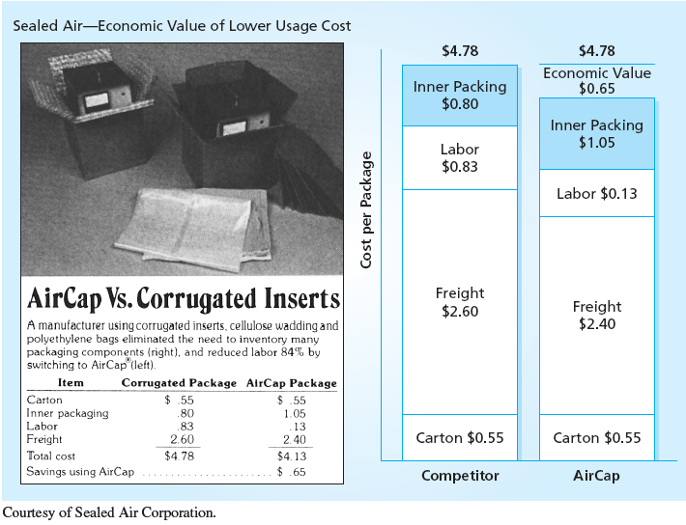
Communicating Value
MBM6
Chapter 4
Copyright Roger J. Best, 2012

Slide 17
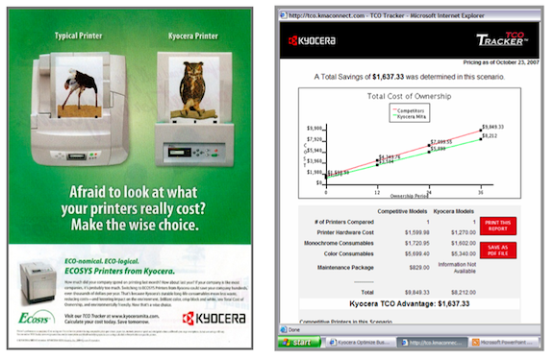
Helping Customers Understand Total Cost of Ownership
MBM6
Chapter 4
What is the goal of the Kyocera Ad and TCO Tracker website?
(Google Kyocera TOC Tracker to see website)
Copyright Roger J. Best, 2012

Slide 18
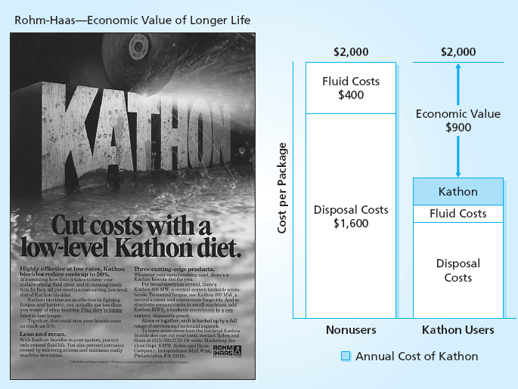
Lowering Disposal Costs as
A Source of Value Creation
MBM6
Chapter 4
Copyright Roger J. Best, 2012

Slide 19
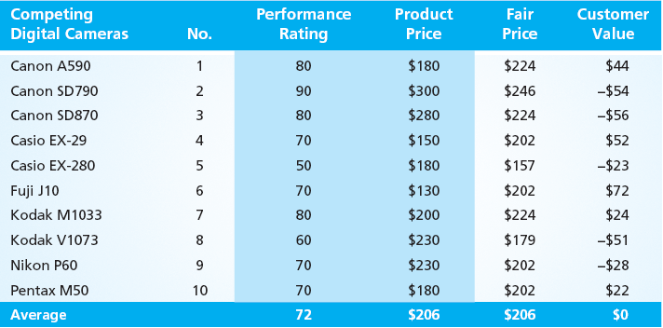
Printer Price and Performance
MBM6
Chapter 4
Why is the Canon A590 a good customer value?
(Data Source: “Digital Cameras,” Consumer Reports (April 2010)
Copyright Roger J. Best, 2012

Slide 20
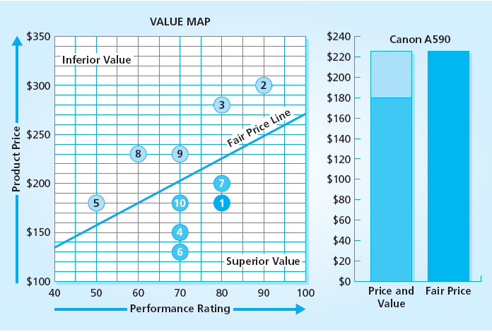
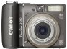
Company Performance
Marketing Performance Tool 4.2
Canon A590
How does the Value Map help the Canon A590 management team interpret the competitor position and value of competing products?
Copyright Roger J. Best, 2012

Slide 21
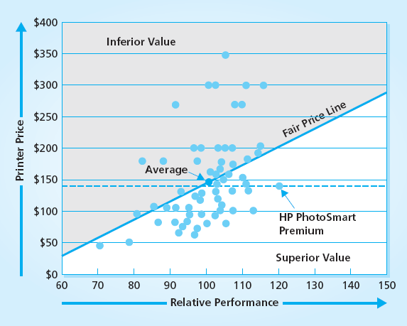
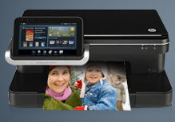
HP PhotoSmart Printer
MBM6
Chapter 4
HP PhotoSmart Premium
Is this HP printer under priced?
What would be a higher price that would still provide an attractive value?
How would this impact profits?
Copyright Roger J. Best, 2012

Slide 22
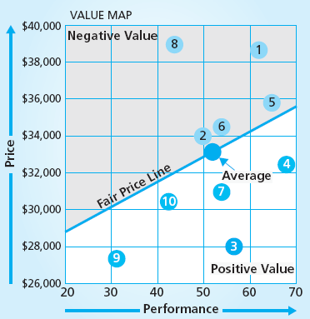
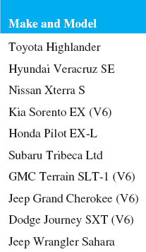
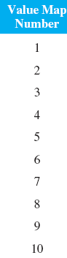
Sport Utility Vehicle Value Map
MBM6
Chapter 4
How would you evaluate the Toyota Highlander value based on these results? (Data Source: “Best and Worst New and Used Cars,” Consumer Reports (2011): 43.)
Copyright Roger J. Best, 2012

Slide 23
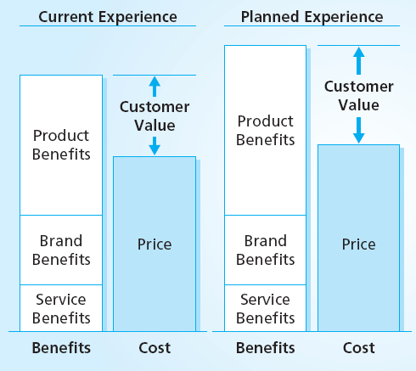
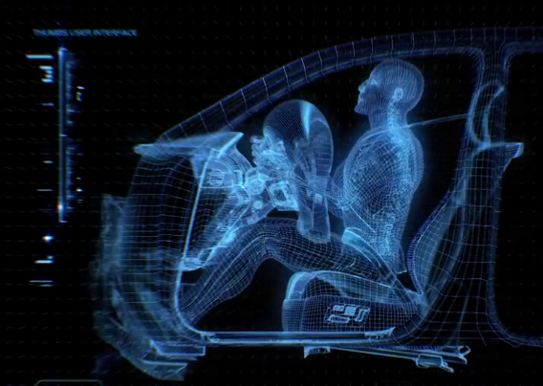
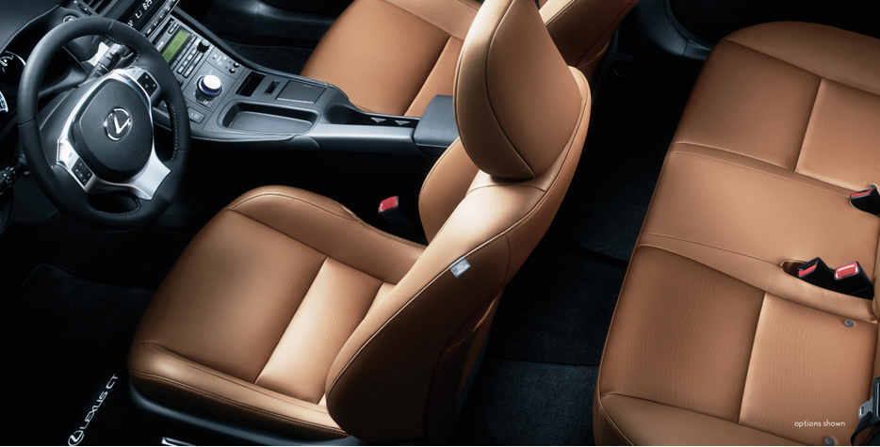
Lexus Customer Experience and Value Strategy
MBM6
Chapter 4
Lexus sets a desired price and then seeks to add product improvements based on customer suggestions. These customer interviews are done one-on-one with customers and Toyota engineers and marketing professionals.
Copyright Roger J. Best, 2012

Slide 24
The Customer Experience
and Value Creation
MBM6
Chapter 4
Measuring Perceived Customer Value
Customer perceptions shape assessments of customer value. However, some aspects of value, like brand reputation, can’t be measured in terms of savings.
Copyright Roger J. Best, 2012

Slide 25
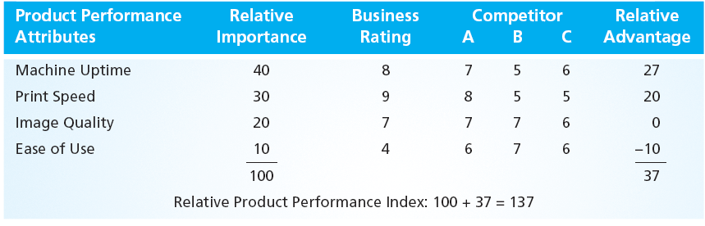
Measuring Perceived Product Performance
MBM6
Chapter 4
1
2
3
When the business is rated 2 or more over a competitor it gets the relative importance points. If it is 2 or more points lower, it loses the relative importance points. Between -1 and +1 no points are won or lost.
Copyright Roger J. Best, 2012

Slide 26
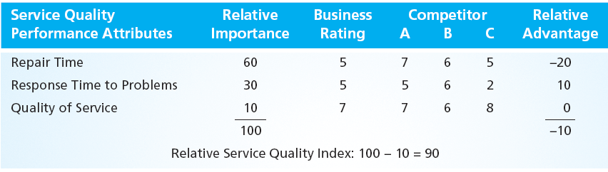
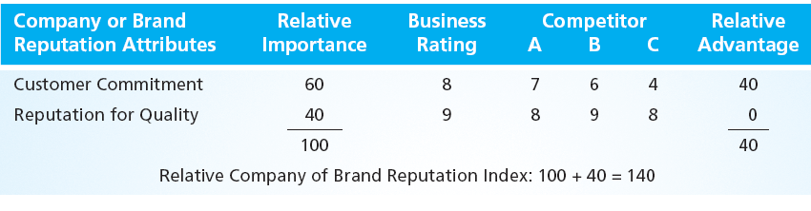
Service Quality & Brand Reputation Perceptions Are Indexed that Same Way
MBM6
Chapter 4
Copyright Roger J. Best, 2012

Slide 27
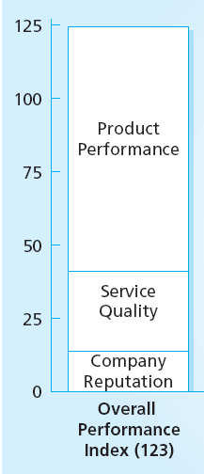
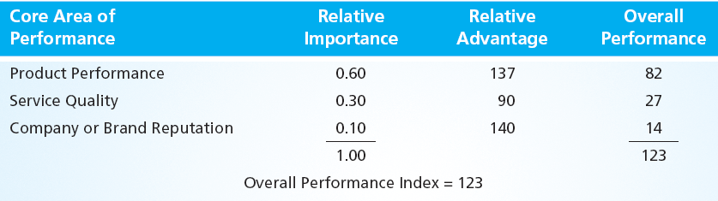
Overall Performance
MBM6
Chapter 4
Because each core area of performance could have different importance to customers, these area are assigned a Relative Importance.
The overall performance is a weighted average of the relative advantage and relative importance for the three core areas of performance.
In this case the overall performance is 123.
Copyright Roger J. Best, 2012

Slide 28
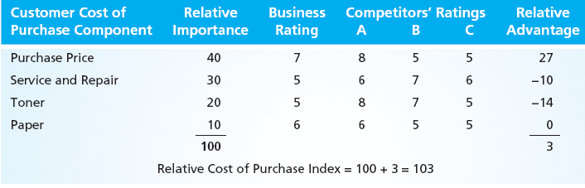
Cost of Purchase
MBM6
Chapter 4
The cost of purchase is rated the same way. However, a higher rating means a higher cost and a lower rating a lower cost.
For the business it’s purchase price is 27% higher but service and repair 10% lower than its three competitors. Overall, their cost of purchase is 3% higher than competitors.
Copyright Roger J. Best, 2012

Slide 29
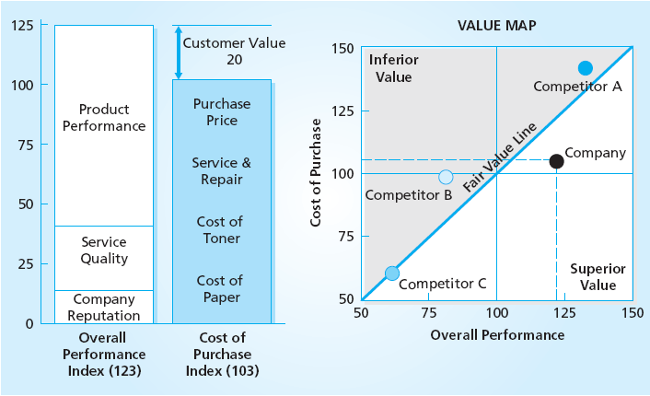
Customer Value Index and Value Map
Marketing Performance Tool 4.3
How would you evaluate the company’s competitive
position and customer value relative to competitors?
Copyright Roger J. Best, 2012

Slide 30
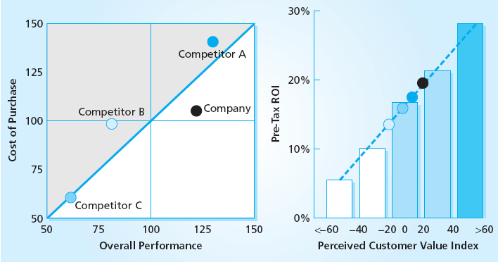
Customer Value and Profitability
MBM6
Chapter 4
Why would the Company be more profitable than Competitor B?
Copyright Roger J. Best, 2012

Slide 31
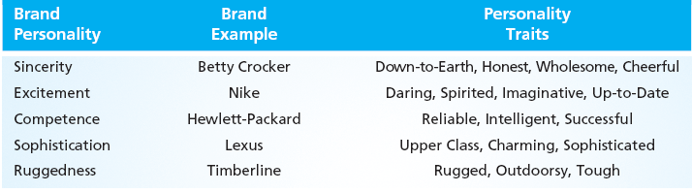


Brand Personality
MBM6
Chapter 4
How would you describe the Abercrombie & Fitch brand personality? Why would it be effective with their target market?
Copyright Roger J. Best, 2012

Slide 32
The Customer Experience
and Value Creation
MBM6
Chapter 4
Identifying Value Drivers and Level of Price Sensitivity
To any customer everything is important.
But, what will they pay for better performance?
Copyright Roger J. Best, 2012

Slide 33
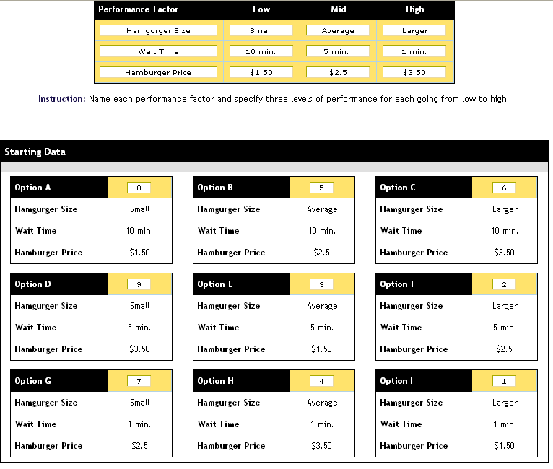
Price-Performance Trade-Offs
Marketing Performance Tool 4.4
Step 1 Set-Up
Step 1:
Set up two performance features each with 3 levels of performance and price at 3 price levels.
Step 2:
Rank the 9 options presented from 1 (most preferred) to 9 (least preferred).
These nine options are a representative subset of 81 combinations.
Step 2 Rank Preferences
Copyright Roger J. Best, 2012

Slide 34
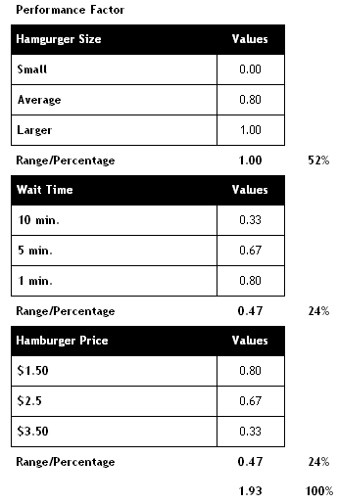
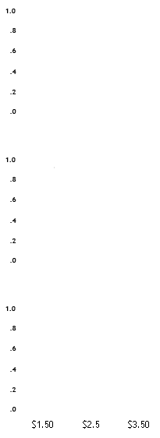
Marketing Performance Tool 4.4
Customer Preferences & Price Sensitivity
Hamburger Size
Customer Preferences
Which factor is most important?
How do customers respond to price?
What is the incremental benefit of a large hamburger over an average size?
What would be the Value Index of a $2.50 hamburger, with average size and 5 minutes wait time?
Small Average Large
Wait Time
1 min. 5min. 10 min.
Hamburger Price
Copyright Roger J. Best, 2012

